Slide 1

Scala Programming Introduction

Slide 2
Agenda
Scala Collections
Scala Collection Hierarchy
Immutable vs Mutable Collections
Collection Operations

Slide 3
Why Should I Learn Scala ?
“If I were to pick a language to use today other than Java, it would be Scala.”
- James Gosling, creator of Java
“Scala, it must be stated, is the current heir apparent to the Java throne. No other language on the JVM seems as capable of being a "replacement for Java" as Scala, and the momentum behind Scala is now unquestionable. While Scala is not a dynamic language, it has many of the characteristics of popular dynamic languages, through its rich and flexible type system, its sparse and clean syntax, and its marriage of functional and object paradigms.”
- Charles Nutter, creator of Jruby
“I can honestly say if someone had shown me the Programming in Scala book by Martin Odersky, Lex Spoon & Bill Venners back in 2003 I'd probably have never created Groovy.”
- James Strachan, creator of Groovy.

Slide 4
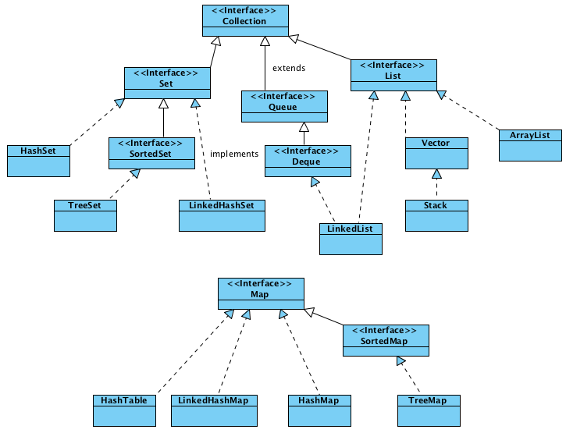
Java Collection Hierarchy

Slide 5
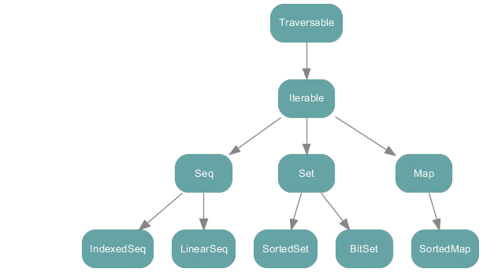
Scala Collection Hierarchy (Traits)

Slide 6
Traversable vs Iterable Trait
Iterators keep state, traversables have no state.
A Traversable has one abstract method: foreach. When you call foreach, the collection will feed the passed function all the elements it keeps, one after the other. The responsibility of operating over elements in the collection is abstracted out from the client.
On the other hand, an Iterable has as abstract method iterator, which returns an Iterator. You can call next on an Iterator to get the next element at the time of your choosing. Until you do, it has to keep track of where it was in the collection, and what's next.

Slide 7
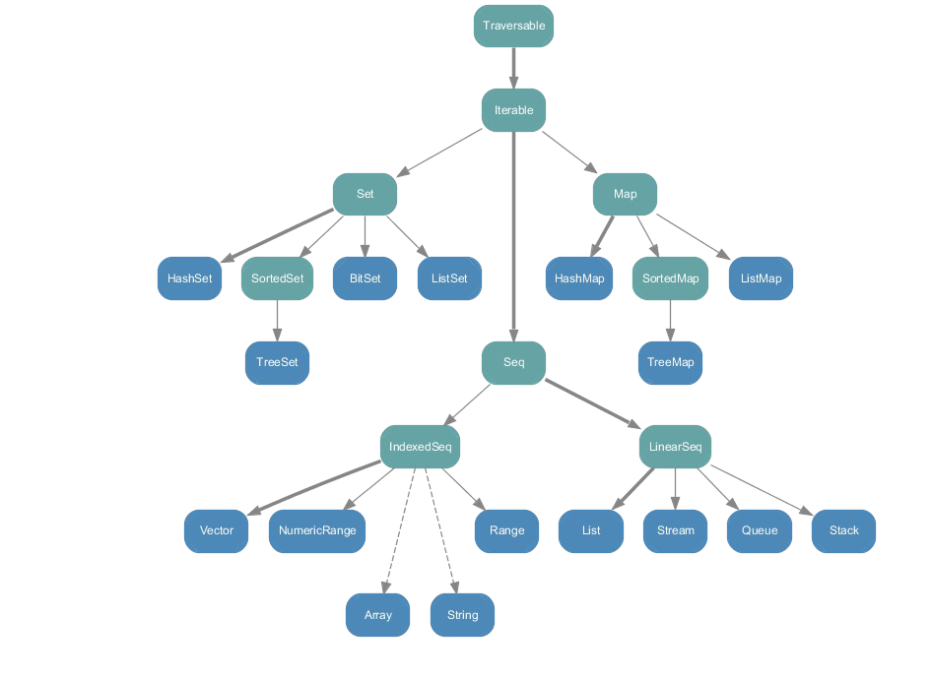
Scala Immutable Collections (Implementations)

Slide 8
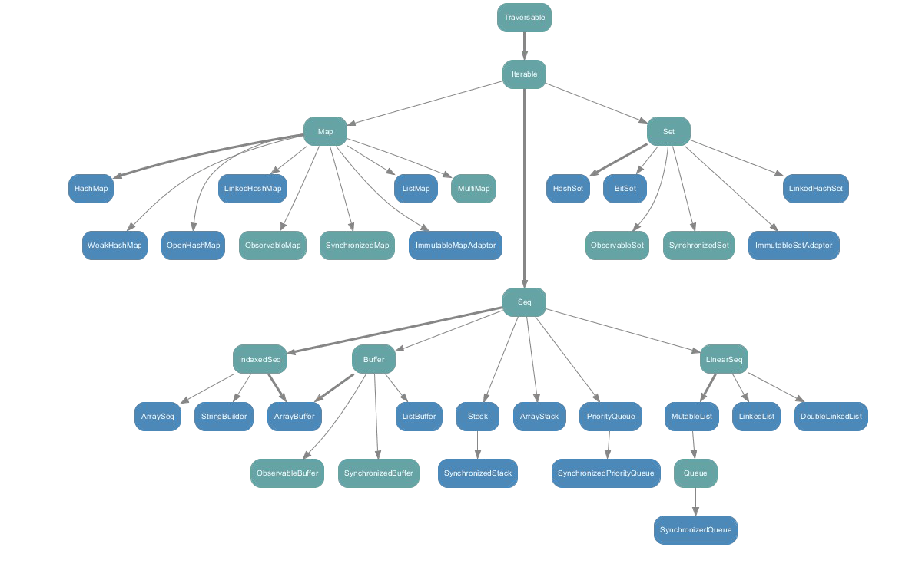
Scala Mutable Collection (Implementations)

Slide 9
Collection Overview
Traversable
Iterable
Seq
IndexedSeq LinearSeq mutable.Buffer Range
Set
SortedSet immutable.HashSet mutable.HashSet mutable.LinkedHashSet BitSet
Map
SortedMap immutable.HashMap mutable.HashMap mutable.LinkedHashMap

Slide 10
Scala Collection Properties
Object-oriented: Don’t allow primitives
Generic with strong compile time type safety: List[T], Map[K, V]
optionally persistent: scala.collections.immutable Higher-order with methods like foreach, map, filter
Uniform return type principle: operations return collections of same type as their left operand

Slide 11
Scala Collection are Consistent
All classes are quite common. For instance, every kind of collection can be created by same uniform syntax:
Traversable(1, 2, 3)
Iterable("x", "y", "z")
Map("x" -> 24, "y" -> 25, "z" -> 26)
Set(Color.red, Color.green, Color.blue) SortedSet("hello", "world")
Buffer(x, y, z)
IndexedSeq(1.0,2.0) LinearSeq(a, b, c)
The same principle applies with specific Collection implementations:
List(1, 2, 3)
HashMap("x" -> 24, "y" -> 25, "z" -> 26)

Slide 12
Scala Collection are Consistent
All these Collections get displayed with toString in the same way they are written above
All collections support the API provided by Traversable but specializes types wherever it makes sense
map method in class Traversable returns another Traversable as its result. But this result type is overridden in subclasses
scala> List(1, 2, 3) map (_ + 1)
res0: List[Int] = List(2, 3, 4)
scala> Set(1, 2, 3) map (_ * 2)
res0: Set[Int] = Set(2, 4, 6)
This behavior in the collections libraries is called the uniform return type principle.

Slide 13
Collection Operations
Top of collection hierarchy. Its abstract method is foreach: def foreach[U](f: Elem => U)
Traversable also provides lot of concrete methods they fall in following categories
Addition: ++, appends two traversables together
Map operations: map, flatMap, and collect
Conversions: toArray, toList, toIterable, toSeq, toIndexedSeq, toStream, toSet, toMap,
Copying operations: copyToBuffer and copyToArray
Size info operations: isEmpty, nonEmpty, size, and hasDefiniteSize Element retrieval operations: head, last, headOption, lastOption, and find Sub-Collection retrieval operations: tail, init, slice, take, drop, takeWhile, dropWhile, filter, filterNot, withFilter
Subdivision operations: splitAt, span, partition, groupBy
Element tests: exists, forall, count
Folds: foldLeft, foldRight, /:, :\, reduceLeft, reduceRight
Specific Folds: sum, product, min, max
String Operations: mkString, addString, stringPrefix

